Slide 1
Helping You Clinically

Slide 2
Welcome to Guy’s and St Thomas’
This booklet has been developed to provide you with important information that will help you clinically.
This booklet covers the following:
Handover Flowchart
Handover Process
E- Noting
Incident Reporting
Major Incidents
Mortuary Services
Bereavement Services
Blood Transfusion
Library and Journals
Apps to Download
Maps

Slide 3
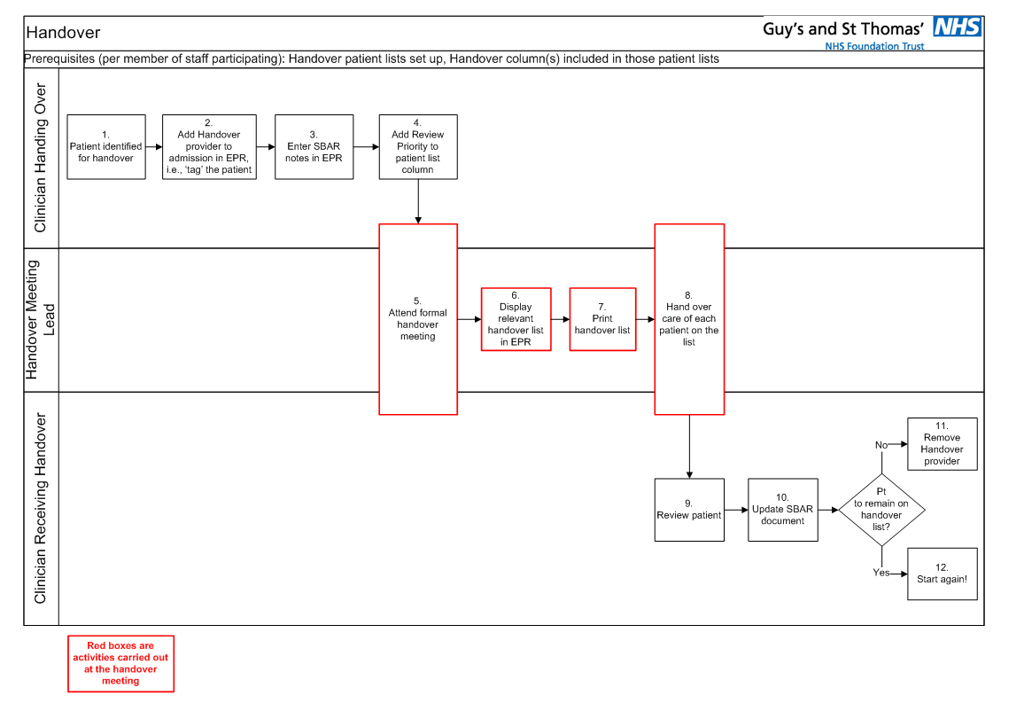
Handover Process Flowchart
1. Handover is a complex process vital to patient safety.
To make things easier Medical Education have created a flowchart and some guidance on the Handover process.

Slide 4
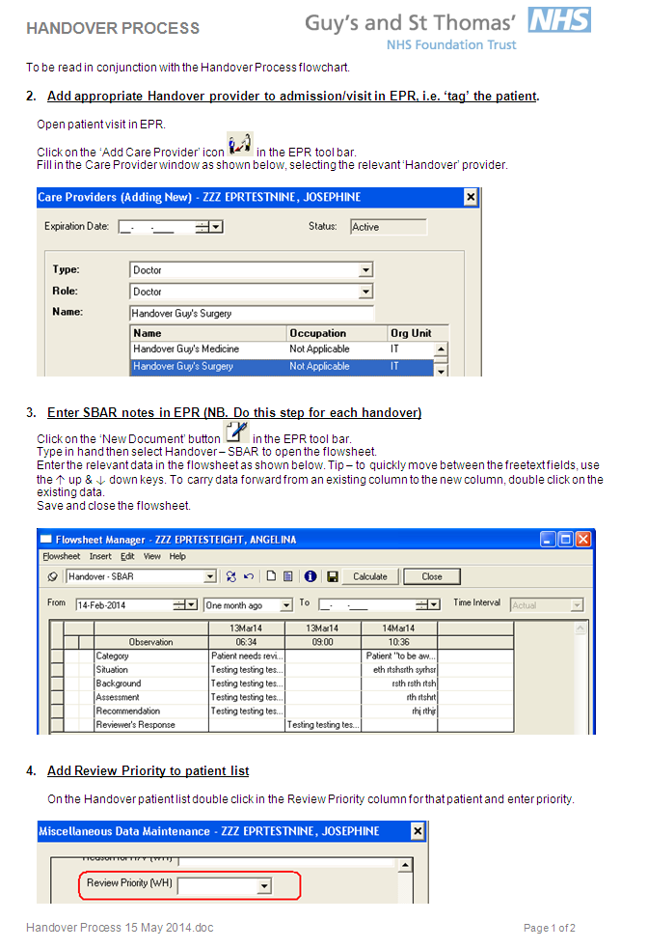
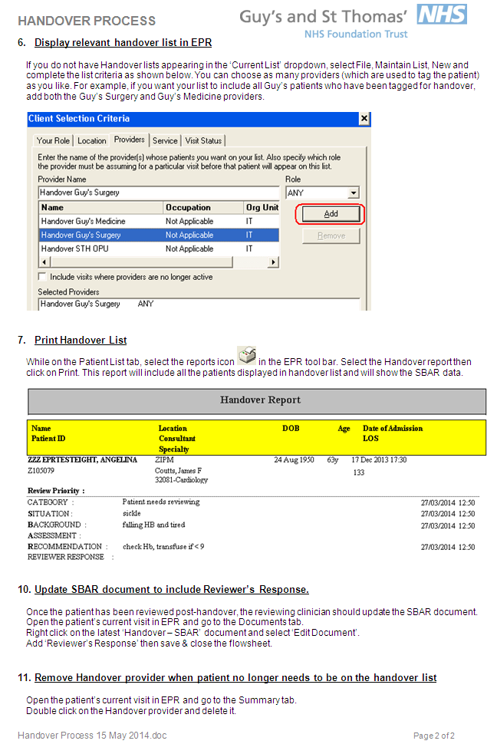
Handover Process

Slide 5
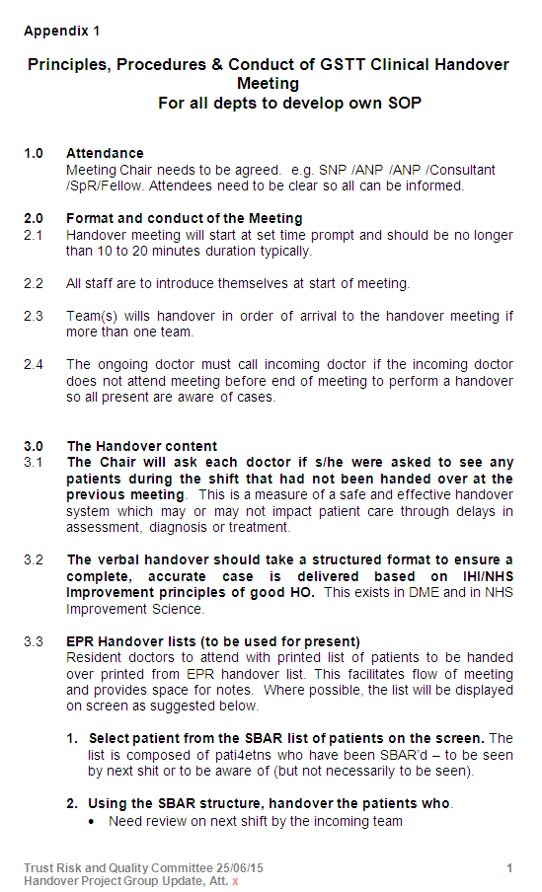
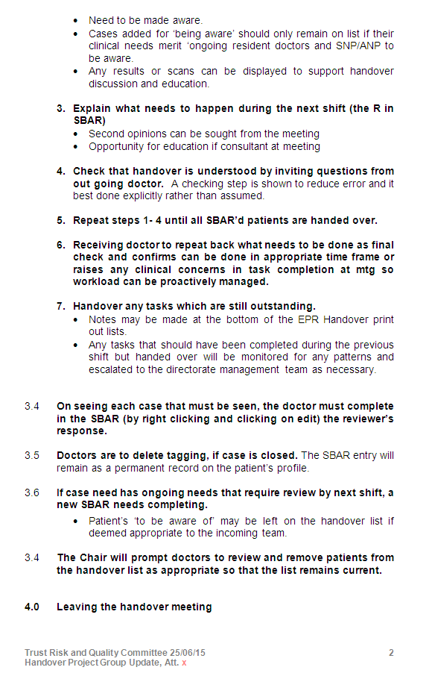
Handover Process

Slide 6
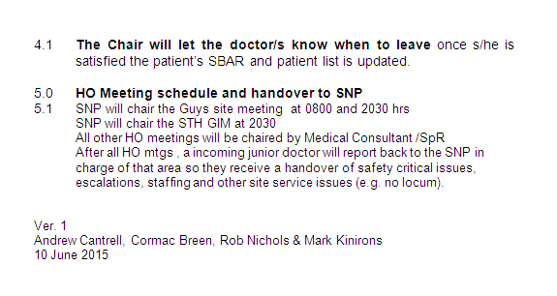
Handover Process
If you have any questions or would like further guidance on the handover process please contact:
Cheng Ong, Deputy Director Medical Education
Email: Cheng.Ong@gstt.nhs.uk

Slide 7
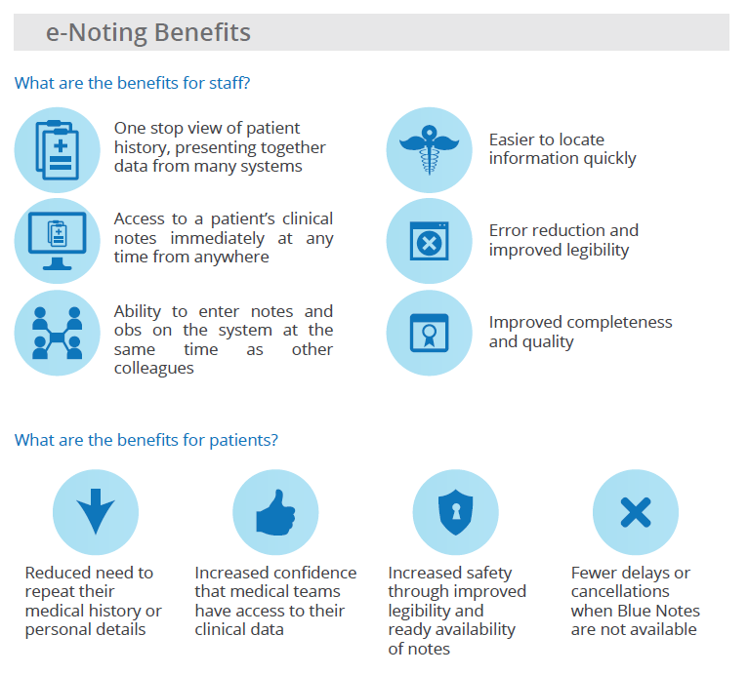
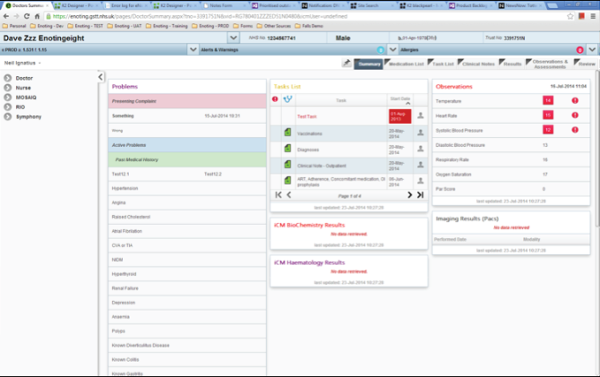
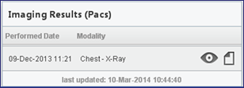
E-Noting
e-Noting is a paper-light, digital noting system that is changing the way we work. It’s an intuitive tool, developed from the ground up with the help of clinical staff and it covers the common clinical forms we use daily. It is in use in all inpatient areas at Guy’s and will be rolled out to inpatient areas in St Thomas’ and in the Evelina London Children’s Hospital during the rest of 2015.
What e-noting does?
e-Noting brings together all of the clinical notes in a readily readable view and groups of observations can be charted to support clinical decisions. Finding patient information now takes seconds. A summary screen or ‘dashboard’ gives a snapshot of what has happened to a patient; showing previous procedures, diagnoses and medical histories at a glance. What’s happening to the patient is visible to the whole team. Hundreds of paper forms have been converted into user friendly, standardised digital 'Smart Forms', utilising drop downs and auto complete to reduce typing and providing assessment scores and alerts in real time. In addition clinical staff can get a view into other systems such as PACs and MOSAIQ directly from e-Noting without having to log in to a separate system.

Slide 8
Incident Reporting
Introduction
Patient Safety is a priority for Guy's and St Thomas‘ and the Trust is committed to providing a safe environment for its patients and staff. The Patient Safety agenda is lead by Dr Adrian Hopper, on behalf of Dr Ian Abbs, who is the Trust's Associate Medical Director for Patient Safety.
The Trust is committed to improving the quality of our services by disseminating learning from incidents. Ultimately learning lessons from incidents is crucial in helping us to provide safer care to our patients and a safer working environment for our staff.
All incidents are reviewed and investigated in line with the policy framework to help prevent recurrence of similar incidents in so far as is reasonably practicable to do so.
What is an incident?
It is an unplanned event with the potential to cause harm, loss or damage.
Types of Incidents
Untoward Incident: is defined as any event that causes or could cause unintended physical or psychological injury to a patient, visitor, or member of staff.
Serious Incident: In broad terms, serious incidents are events in health care where the potential for learning is so great, or the consequences to patients, families and carers, staff or organisations are so significant, that they warrant using additional resources to mount a comprehensive response. Serious incidents can extend beyond incidents which affect patients directly and include incidents which may indirectly impact patient safety or an organisation’s ability to deliver ongoing healthcare.
Never Events: Never events are serious incidents that are considered to be wholly preventable. This is because guidance or safety recommendations that provide strong systemic protective barriers are available at a national level and should have been implemented by all healthcare providers. Each never event type has the potential to cause serious patient harm or death. However, serious harm or death is not required to have happened as a result of a specific incident occurrence for that incident to be categorised as a Never Event.
No Harm Incidents
An incident was prevented (near miss):e.g. a nurse went to administer zopiclone to a patient but realised that the dosage was incorrect and contacted the prescriber to amend the dosage.
The incident happened but caused no harm e.g. Paracetamol was prescribed for a patient which the nurse administered but then discovered it should have been prescribed for a different patient.
When and How to Report?
Please report incidents as soon as possible after you have made the situation safe. All Trust employees are responsible for reporting incidents and supporting investigations.
The electronic incident reporting form can be found on the front page of the intranet: GTi; left hand side under Tools listed as IR1 incident reporting.
Please make sure that you include patient/staff details involved in the relevant sections. Do NOT include patient / staff identifiable information in the description section because this is not a confidential area of the form.

Slide 9
Incident Reporting
In Summary
Put safety at the top of your priorities.
Communicate, communicate, communicate.
Encourage a fair and open culture.
Be aware of risk assessments and safe systems relevant to your work.
Ask for help when you need it and don’t take risks by leaving it too late.
Be open and honest with patients and with other staff.
Take immediate action to make the situation safe.
Report incidents to your manager and on Datix.
If something goes wrong, take time to identify how you can learn from it
.
Respond in a timely manner if you are asked for information.
Duty of Candour – Organisational Responsibility
As an organisation we have a responsibility to report back to a patient if there has been an incident of potential or actual harm. If you have been involved in an incident speak to your educational/clinical supervisor who will advise you on next steps.
The Duty of Candour is a contractual arrangement in relation to incidents that involve actual or suspected harm. The organisation is responsible for an initial open and honest verbal notification with the patient within 10 days of the incident being reported, along with a sincere apology. An offer of a written explanation and apology should also be made. Full written documentation of all meetings should be recorded in the patient’s notes for audit purposes. The patient should be involved in the investigation if they would like to be. The organisation also have a responsibility to share the investigation report with the patient and this should be offered within 10 days of sign off by the patient safety team.
If you have and questions please feel free to contact the Patient Safety team for any advice
Tel ext: 81567/ 81513
Email: datixadmin@gstt.nhs.uk
Intranet page: GTi/ services/ a-z non-clinical departments/ risk management department

Slide 10
Major Incidents
For the NHS, a Major Incident is defined as:
A major incident is any event whose impact
can not be handled within routine service
arrangements. It requires the implementation of special procedures by one or more of the emergency services, the NHS or a Local Authority to respond to it due to
A serious threat to the health of the community
Disruption to the service, or causes (or is likely to cause) such numbers of types of casualties as to require special arrangements to be implemented by hospitals
What to do in an emergency
If working, carry on as normal unless directed otherwise or if your role has been identified by an Action Card
If you are called in, report to:
Staffing Control Centre
St Thomas’ Hospital, Nevin Lecture Theatre
If you’re not working, do not come to work unless contacted; do not contact switchboard or the Duty SNP
Staff must not:
Respond to or contact the press or media
Phone switchboard and ask for information
Cross the barrier if in use
If you are requested to assist please:
Attend the Nevin Lecture Theatre and report in taking your Trust ID badge whilst wearing it all times.
The Trust Major Incident Plan can be found on the Intranet homepage via Quick Links.
It is important that all staff who may expect to be involved must read and familiarise themselves with the Major Incident Plan, paying particular attention to their specific Action Card.
Please inform your Line Manager of changes to personal contact details.
NHS Alert Messages
In order to avoid confusion about when to activate plans, standard messages are used to identify and implement the stages of the response:
Major Incident - STANDBY | This alerts the NHS that a major incident may need to be declared
Major Incident DECLARED – Activate Plan | This alerts NHS organisations that they need to activate their plan and mobilise additional resources
Major Incident - CANCELLED | This message cancels either of the two above messages at any time
Major Incident – STAND DOWN | This message indicates that a Major Incident response is no longer required.
The Ambulance Service has the responsibility to alert NHS organisations in the event of major incident and/or civil emergencies. This is one of the routes through which the Trust may receive notification of a major incident and the possible need to activate the Trust Major Incident Plan.

Slide 11
Major Incidents
Business Continuity Management (BCM)
Why do we do business continuity at GSTT?
We are a patient focused organisation
Patient safety, patient experience and clinical outcomes can be affected by disruptive events.
It is a statutory duty. Commissioners require service level Business Continuity Plans (BCP).
Rehearsed and flexible plans ensure effective incident response.
It is sound business sense
BCM reduces costly disruption, maximises operational efficiency and informs investment in the most effective areas.
It protects our reputation.
We want to continually improve
BCM provides a managed system to report, debrief and learn from internal incidents, improving our response and resilience.
All Staff are expected to:
Keep your contact information always up to date.
Take part in scenario based exercises to understand your role in your service continuity plan.
Alert your manager or service continuity plan author if business continuity incident triggers are met.
Be prepared to work flexibly during incidents.
Raise Business Continuity incidents and near misses as IR1s so we can ensure lessons are learnt and risks are proactively managed.
What is an Internal Incident?
Disruption is on a sliding scale. Examples of Trust level triggers
If you have any questions please contact:
Justin Cuckow, Senior Emergency Planning Officer (BC)
Tel: 0207 188 0535
Email: Justin.cuckow@gstt.nhs.uk
Loss or disruption to | Internal Incident Trigger | Impacts
Premises / Utilities | ◊ Ward evacuated e.g. Fire / flood / shooting ◊ Loss of Power / water heating affecting critical activities | Patient, staff, visitor, safety Site safety Operational efficiency / Financial loss Ability to meet legal Statutory duties External reputation
People / Transport | ◊ Lack of staff impacting critical activities ◊ Excess demand / flow alerts ◊ Significant disruption to transport
IT & Telephony | ◊ Prolonged “Serious IT incident”
Supplies & equipment | ◊ Prolonged loss of laboratory / diagnostic services ◊ Critical supply chain / equipment failure

Slide 12
The Mortuary Bereavement Services
The Mortuary & Bereavement Service has a multi faceted role providing services to the hospital and community, caring for the deceased patient, delivering bereavement support to the deceased patient’s family, and providing high-quality diagnostic services through post-mortem examinations
Mortuary
The Mortuary at St Thomas’ Hospital is open Monday to Fridays:
For telephone enquiries: 8am to 4pm 0207 188 3928
For Dr’s and Funeral Directors: 10am to 12.30pm and 1.30pm to 3pm.
The Mortuary at Guy’s Hospital is open Monday to Friday 2pm to 4pm any enquiries for access please call the STH Mortuary.
There is also an 24 hour emergency on call service that can accessed via aircall – bleep number 868342.
At the Mortuary we conduct both Coronial and Consented Post Mortem examinations.
In regards to Adult Consented Post Mortem’s Guy’s and St Thomas’ NHS Foundation Trust has its own Post Mortem Consent Form. Any one wishing to seek consent from a next of kin must be trained by key trainers within the trust.
In regards to Perinatal and Paediatric Post Mortem’s we employ the use of the Sands consent form. As above, anyone wishing to seek consent must be trained by a key trainer.
Training can be provided in a multitude of ways and is usually provided by one of the Mortuary staff.
Your consultant may arrange a training session for you and your colleagues; you can request a training session for you and your peers or you can request a one-on-one session.
Adult Post Mortem consent packs are available upon request from the Mortuary. The Sand Consent form is currently available on the Mortuary page of the Trust’s intranet
If you have any further questions please contact:
Mortuary Services Team
Tel: 0207 188 3928
Email: :bereavement

Slide 13
The Mortuary Bereavement Services
Bereavement
The Bereavement Office at St Thomas’ Hospital is open Monday to Fridays from 9am to 5pm. Telephone number: 0207 188 3182
The Bereavement Office at Guy’s is open when required. Please call St Thomas’ to discuss.
Once a death has occurred on the ward the verifying doctor must confirm the death in the patient’s notes and clearly write their name and bleep number/s.
The trust allows 48 hours after death for the MCCD to be completed by a doctor in the team that was taking care of the patient during the last admission or the last two weeks of admission if a long stay patient. This allows the doctors time to discuss the case with the consultants and other members of the medical team and also time to refer the case to the coroners office if necessary.
If the death needs to be discussed with the coroners office then a referral form must be written and emailed to :bereavement
Deaths should be reported to the coroner’s office promptly, within 24 hours of death, if the medical team are unsure as to what should be reported to the coroner’s office then they can contact the bereavement centre for further advice.
Referral forms
Trust intranet Mortuary page /right hand side coroners referral form, attach completed form in an email to :bereavement
The family will notify the Bereavement centre regarding the funeral type ie burial, Cremation or Repatriation.
Cremation will require cremation papers which the certifying Doctor is usually responsible for and the Doctor will need to see the patient after death.
Repatriation may require a free from infection form or a notice of infection form also completed by the certifying doctor.
Payment for the above documents will be in cheque form and should be collected via the bereavement office (Wednesday-Friday only)
EDL’s must be completed on the ward. The EDL should be completed as soon as possible for funding purposes and the recovery of monies for treatment received
If you have any further questions please contact:
Mortuary Services Team
Tel: 0207 188 3928
Email: :bereavement

Slide 14
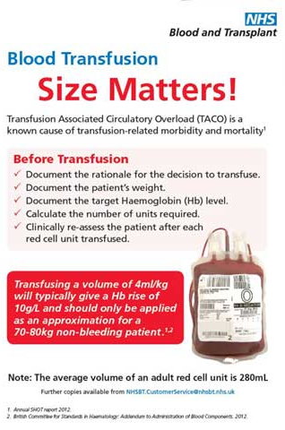
Blood Transfusion

Slide 15
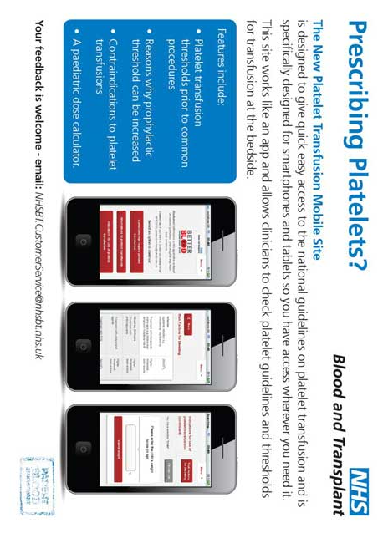
Blood Transfusion
If you have any further questions please contact:
Transfusion Practitioners
Tel ext: 82720

Slide 16
Library and Journals
Staff have access to KCL library facilities and journals. Below is a list of all the facilities available to you:
St Thomas’ House (by the Evelina)
Knowledge & Information Centre (KIC) near main lifts at Tommies
1st floor New Hunt’s House (opposite Guy’s main entrance)
Wills Library (24 hours across from New Hunt’s House)
Other KCL Libraries – Denmark Hill, Waterloo, the Maughan
Online via www.evidence.nhs.uk
You can self register for access through OpenAthens (www.athens.nhs.uk) or for any self registration queries please contact nhsenquiry@kcl.ac.uk
For training and support please contact Alan.Fricker@kcl.ac.uk
For any other quries please visit http://libguides.kcl.ac.uk/nhs or email libraryservices@kcl.ac.uk

Slide 17
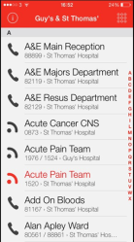
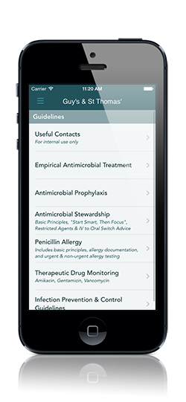
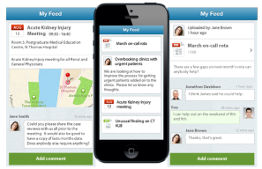
Apps to Download
There are a range of Apps available to you that will help you in your role at the Trust.
These apps have been developed to support you and are available on Android and IOS.
Get the latest news, information, videos and much more from Careflow, or use it to communicate your ideas to the trust and your teams.
Real-Time Clinical Alerts
Push vital patient information to care teams instantly, delivering the right data at the right time to the right people. We make it easy to integrate your existing data systems and mobilise automated alerts.
BleepPod is a directory for Bleep numbers at the Trust and can be downloaded from the app store.
Mobile care coordination
Bring care teams together, wherever they are. Careflow Connect establishes conversations around the patient’s care and updates the care team in real-time for quicker decision making, continuous handover and safer referrals.
Keeping patient data safe
Developed with strict security and information governance requirements for healthcare at its core, Careflow Connect provides secure and audited messaging meeting the highest compliance standards worldwide.
Infections: the antimicrobial prescribing smart phone app for Guy’s & St Thomas’ for iPhone, iPad & iPod Touch running iOS 6.0 or later.
Android version coming soon.
Enter the password ‘infection’ in the settings menu to unlock additional content
Register for Careflow on the web at www.careflowconnect.com or download the app.

Slide 18
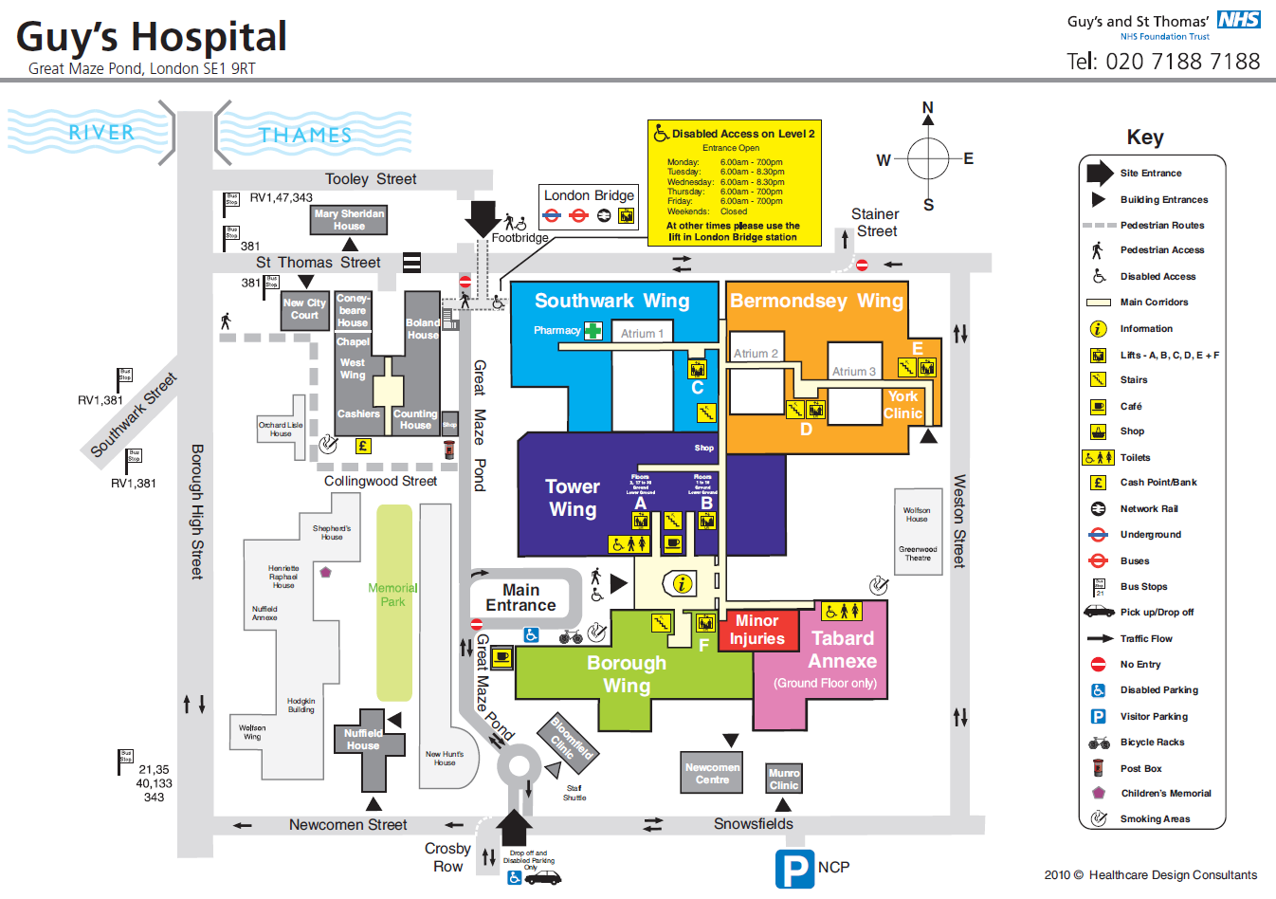

Slide 19
